Slide 1
Model evaluation and optimization
Machine Learning with Python

Slide 2
Evaluation metrics for regression
Machine Learning with Python

Slide 3
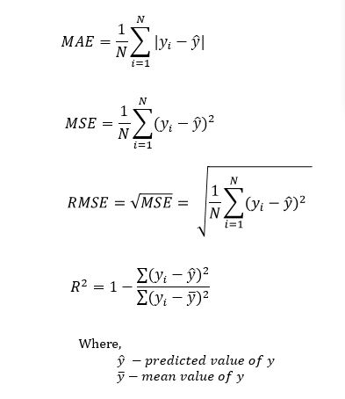

Slide 4
Evaluation metrics for classification
Machine Learning with Python

Slide 5
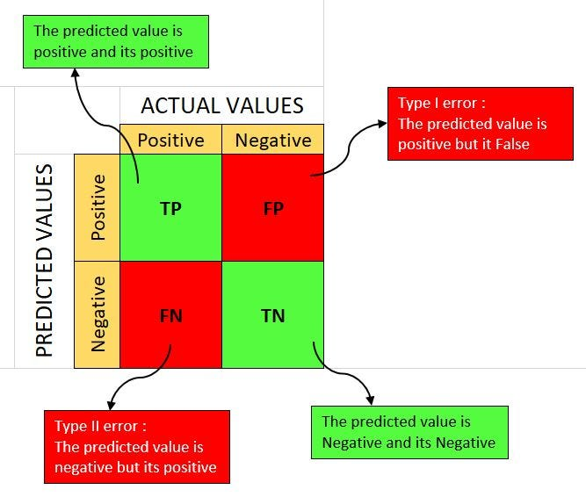

Slide 6
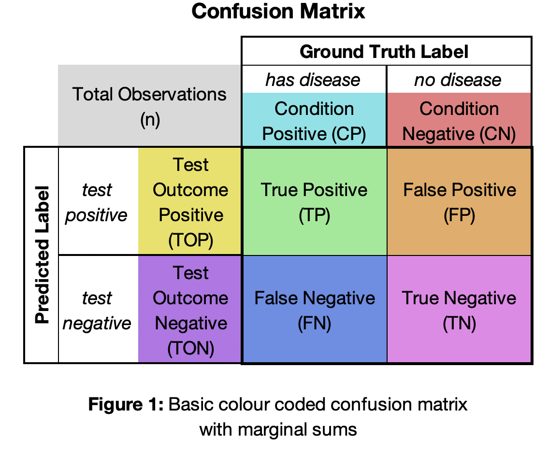

Slide 7
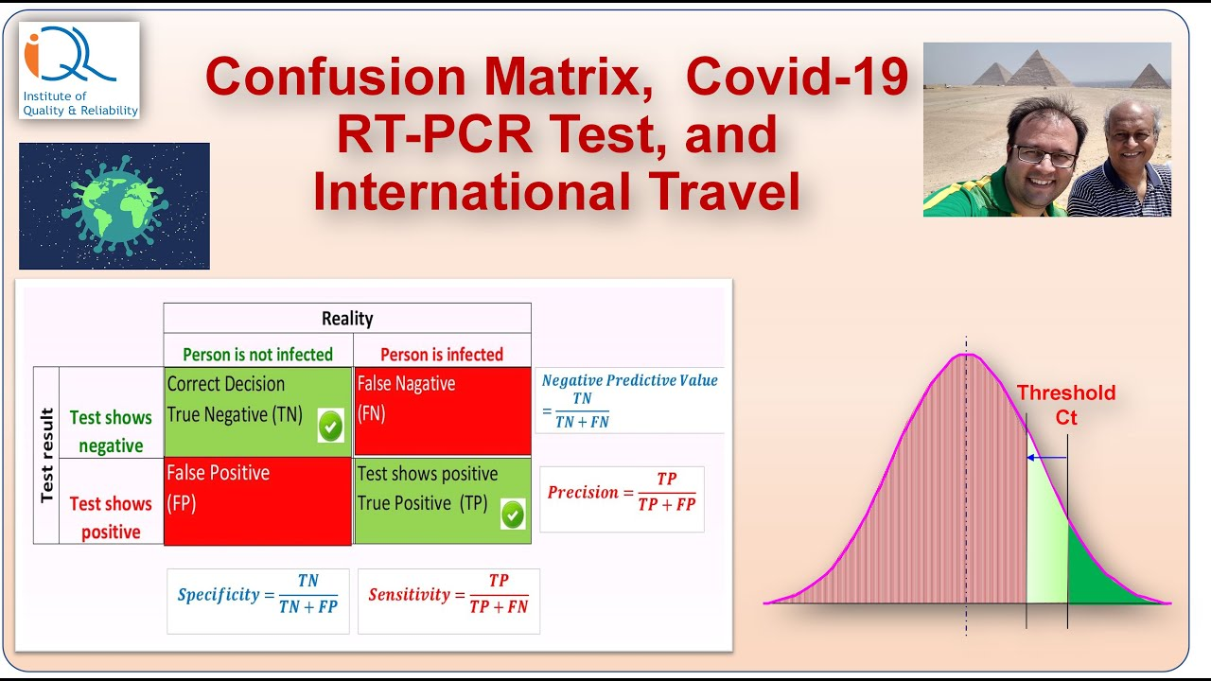

Slide 8
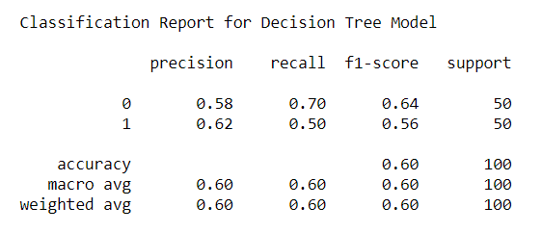

Slide 9
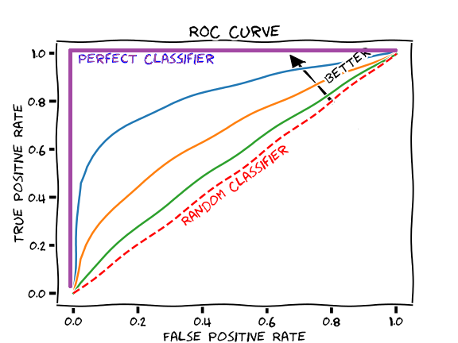

Slide 10
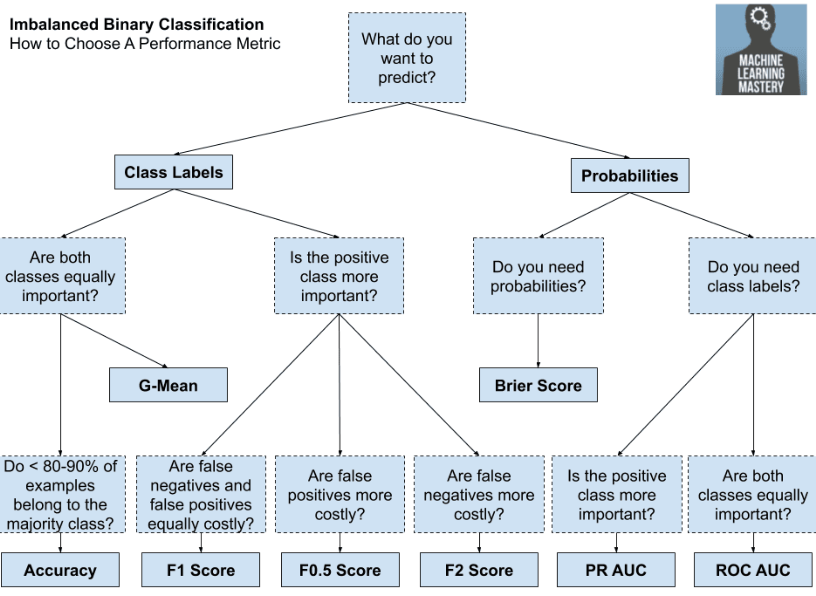

Slide 11
Overfitting / underfitting
Machine Learning with Python

Slide 12
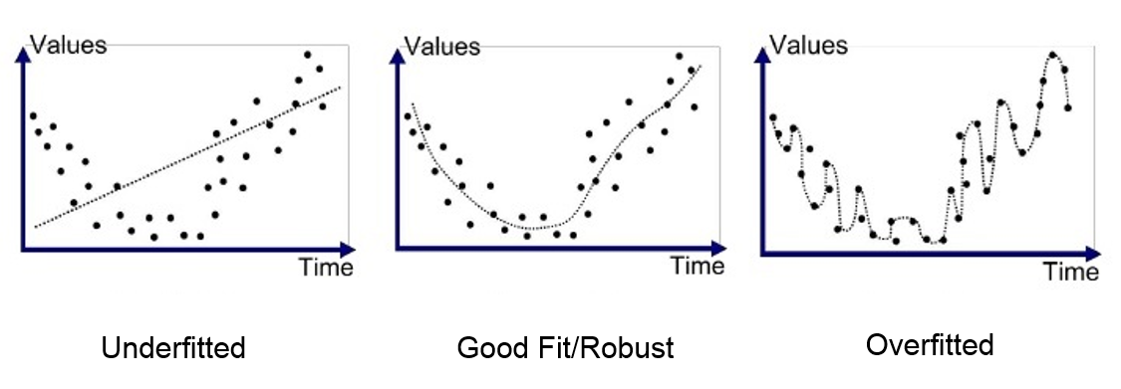

Slide 13
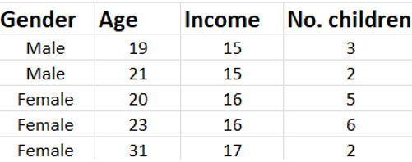
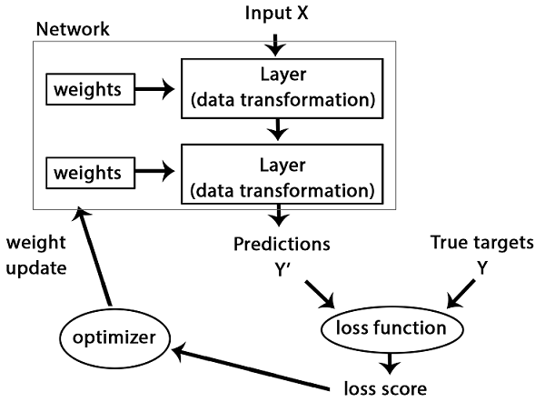
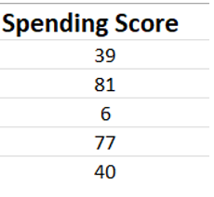

ML internal operation for supervised learning
Input / independent / feature variables
Output / dependent / target variable (label)

Slide 14
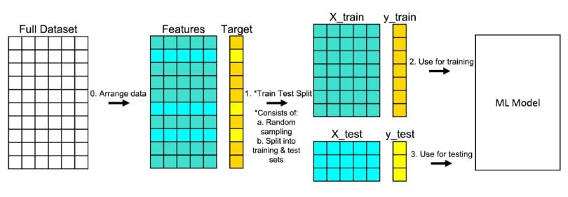
Training and data test split

Slide 15
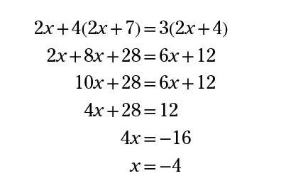
Model creation analogy
Student (ML algo) needs to figure out the correct series of steps (ML model) from original problem statement to reach the final answer
Teacher gives students the original problem statement (feature variables) and the
final answer (target variable)
-7
Correct answer is -4, but teacher makes a mistake !
This is noise in the environment
There are many sets of problems and sample answers given (training set)

Slide 16
Underfitting
Student (ML algo) only manages to figure out some of the steps (ML model) to reach the provided answer
Therefore, all answers (predicted values) for existing problems (training data) as well as new problems (test dataset) will be incorrect and FAR (high bias) from the actual value, but will be consistently wrong (low variance)
-7
Correct answer is -4, but teacher makes a mistake !
This is noise in the environment

Slide 17
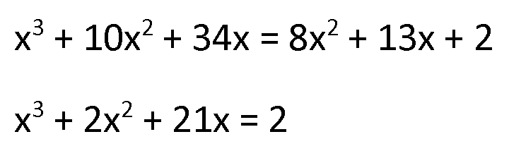
Overfitting
Student (ML algo) manages to figure out all of the steps (ML model) to reach an answer (-4) that is different from the provided answer
Student believes that the answer that the teacher gives is the best one to strive for, and makes radical changes to the steps (ML model) to force it to produce the incorrect answer !
Therefore, all answers (predicted values) for existing problems (training data) will be 100% correct (low bias), but for new problems (test dataset) will be either VERY CLOSE or VERY FAR away (high variance)
Reformulation of the original steps (ML model) to a different form so that it will produce the incorrect answer !
-7
Correct answer is -4, but teacher makes a mistake ! This is noise in the environment

Slide 18
Optimal / balanced
Student (ML algo) manages to figure out all of the steps (ML model) to reach an answer (-4) that is different from the provided answer
Student also figures out that discrepancy between steps and answer is due to mistake by teacher (noise), and NOT mistake in the steps.
Therefore, all answers (predicted values) for existing problems (training data) as well as new problems (test dataset) will be nearly correct (low bias) and will be consistently the same (low variance)
Correct answer is -4, but teacher makes a mistake !
This is noise in the environment
-7

Slide 19
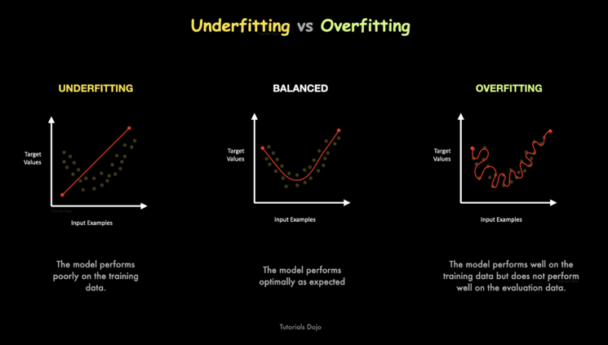

Slide 20
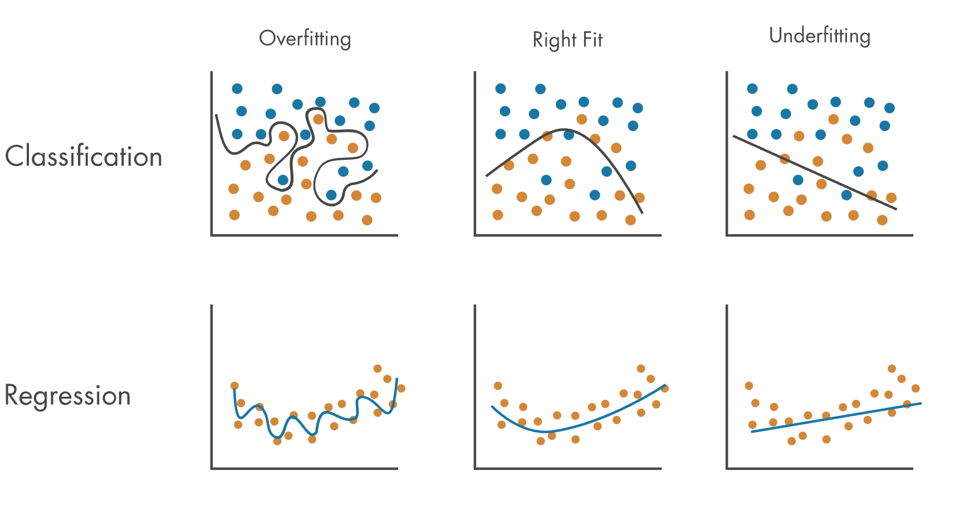

Slide 21
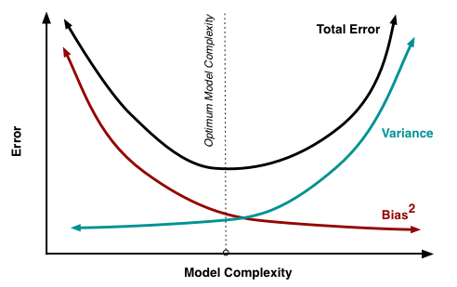
Bias variance tradeoff

Slide 22
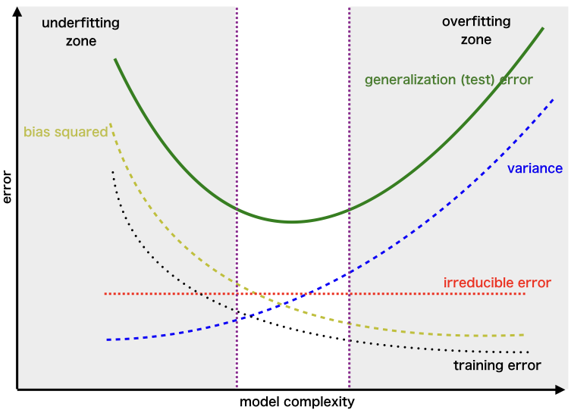
Bias variance tradeoff

Slide 23
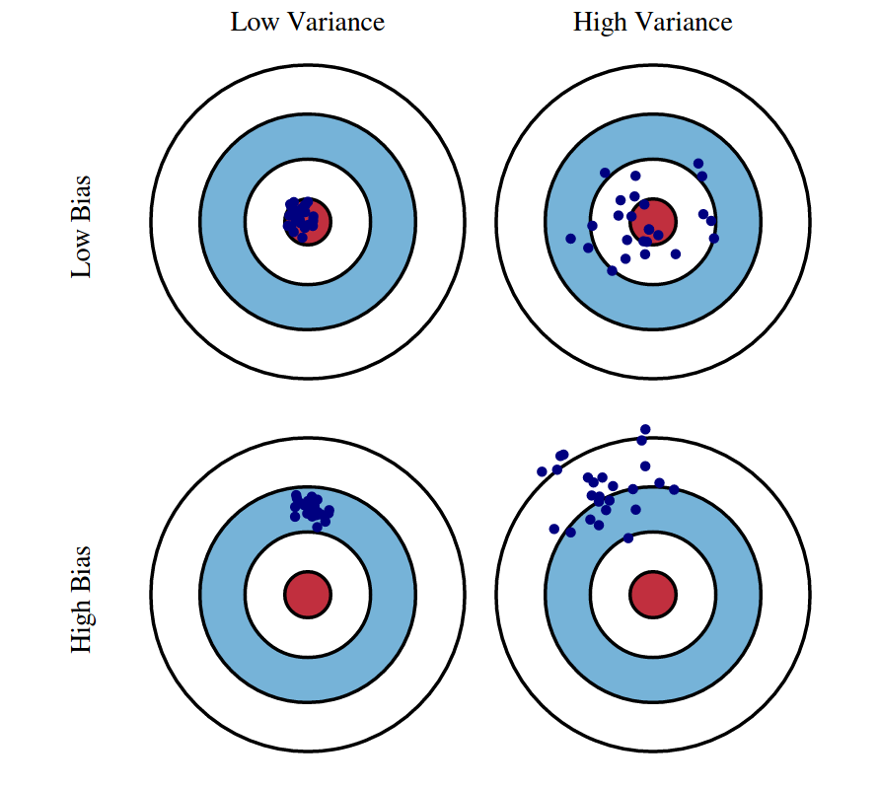
Bias variance tradeoff
Optimal complexity
Overfitting
Underfitting
BAD MODEL FIT !
Choose another algo (Logistic, KNN, Naïve, Random Forest, SVM, etc

Slide 24
Hyperparameter tuning
Machine Learning with Python

Slide 25
ML internal operation for supervised learning

Slide 26
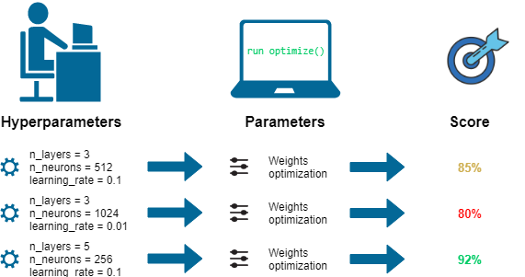
Hyperparameter tuning

Slide 27
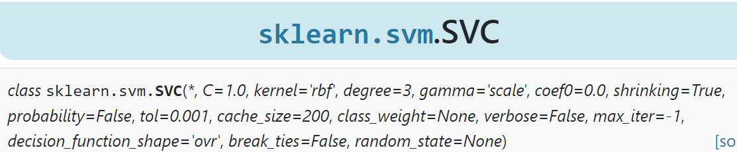
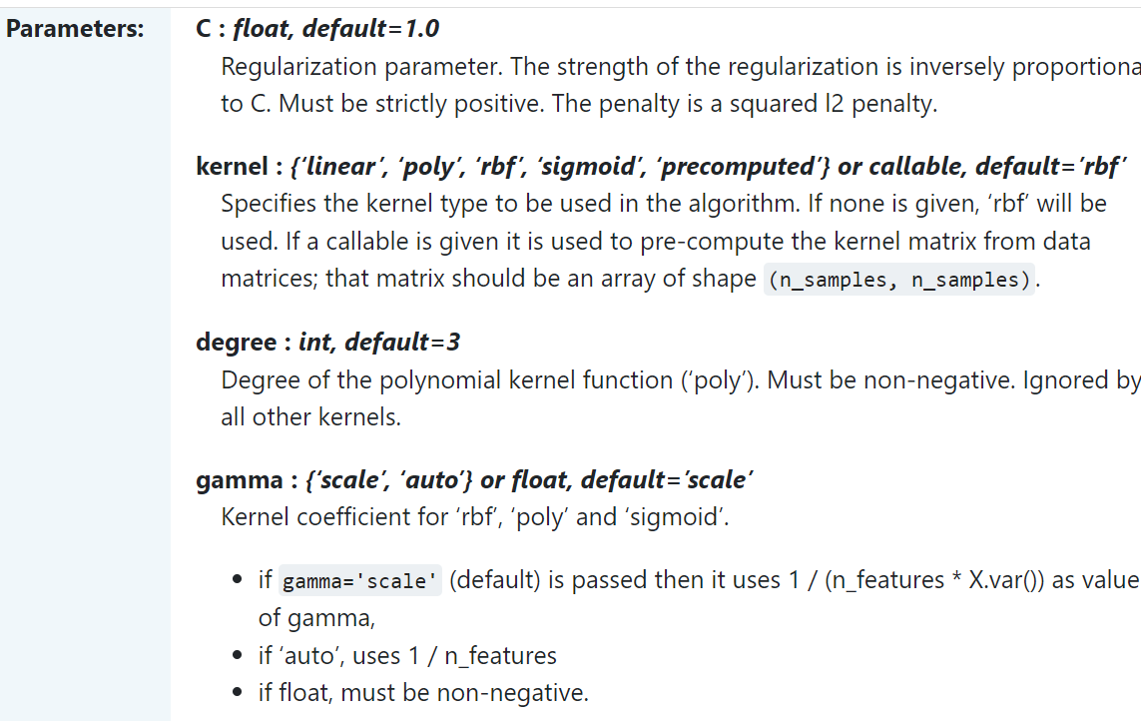
Hyperparameters

Slide 28
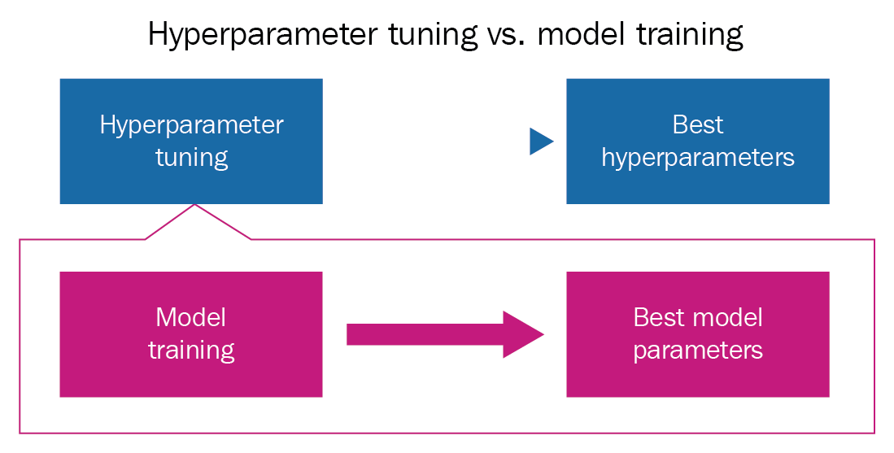
Hyperparameters vs model parameters

Slide 29
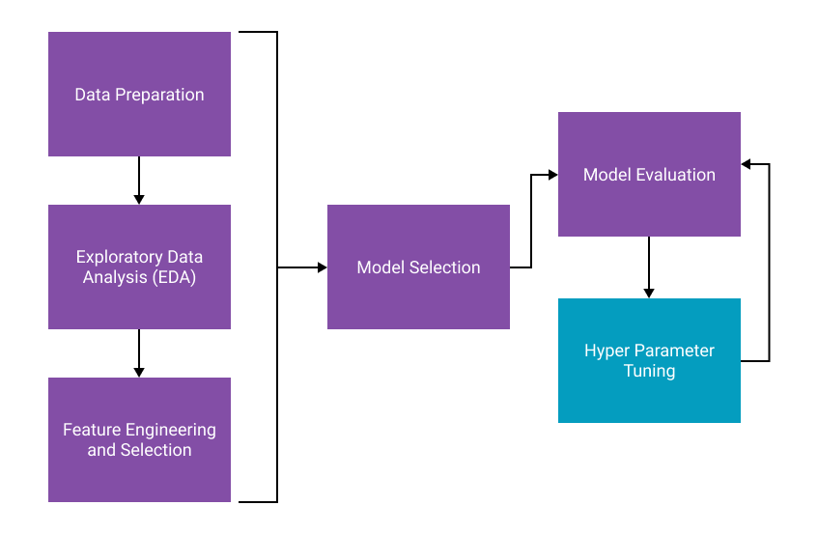
Hyperparameter tuning

Slide 30
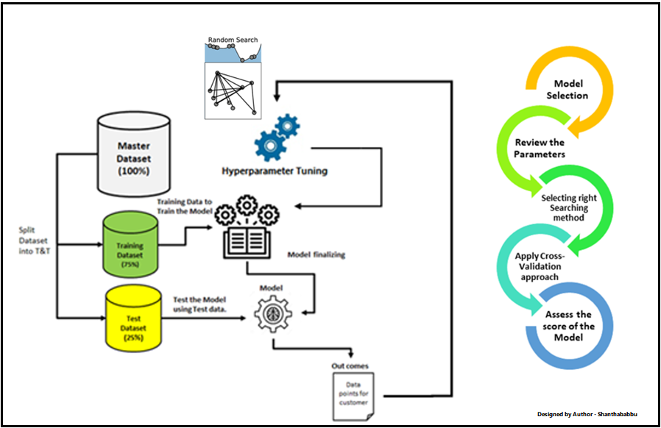
Hyperparameter tuning

Slide 31
K-Fold Cross Validation
Machine Learning with Python

Slide 32
Training and test split

Slide 33
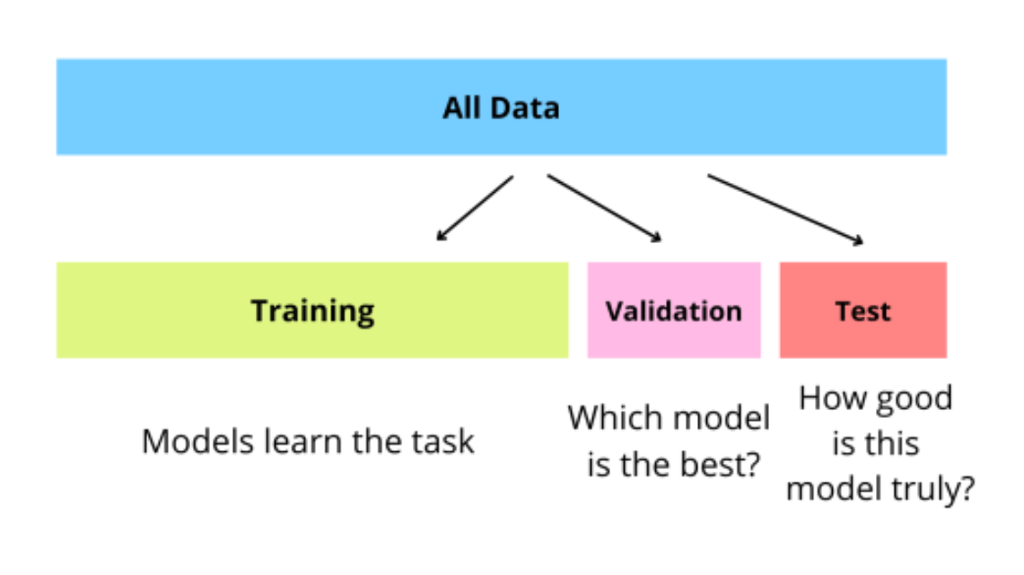
Training, test and validation split

Slide 34
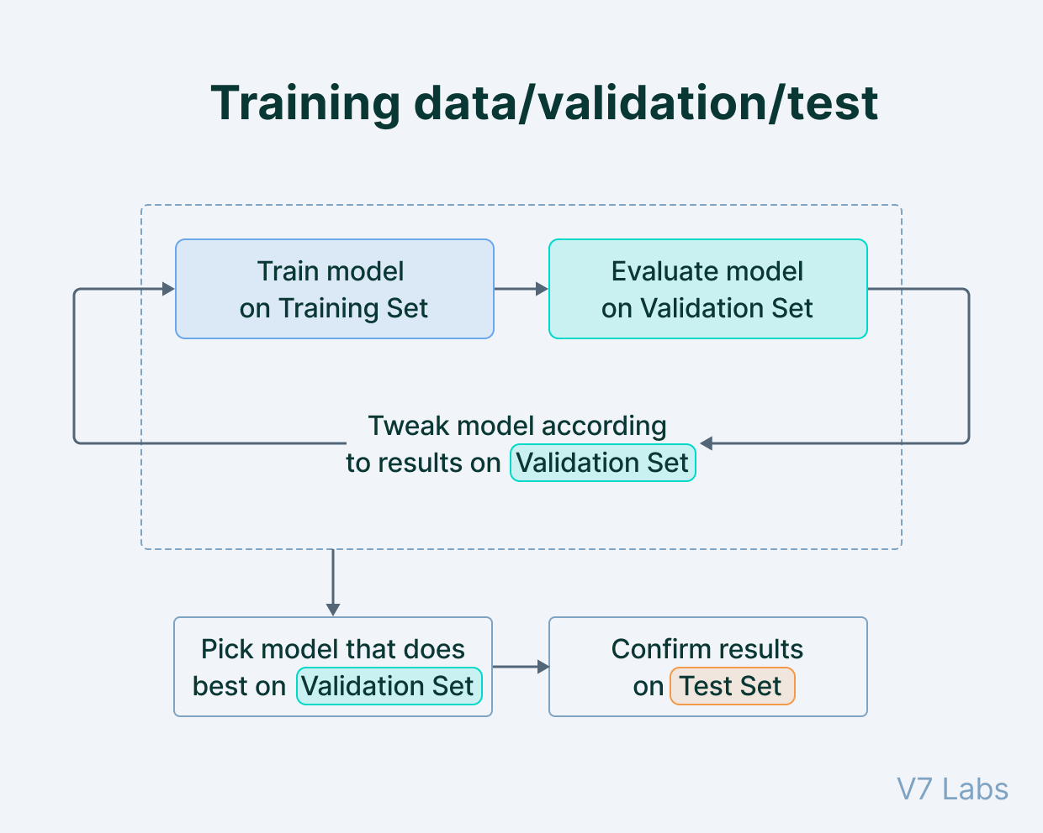

Slide 35
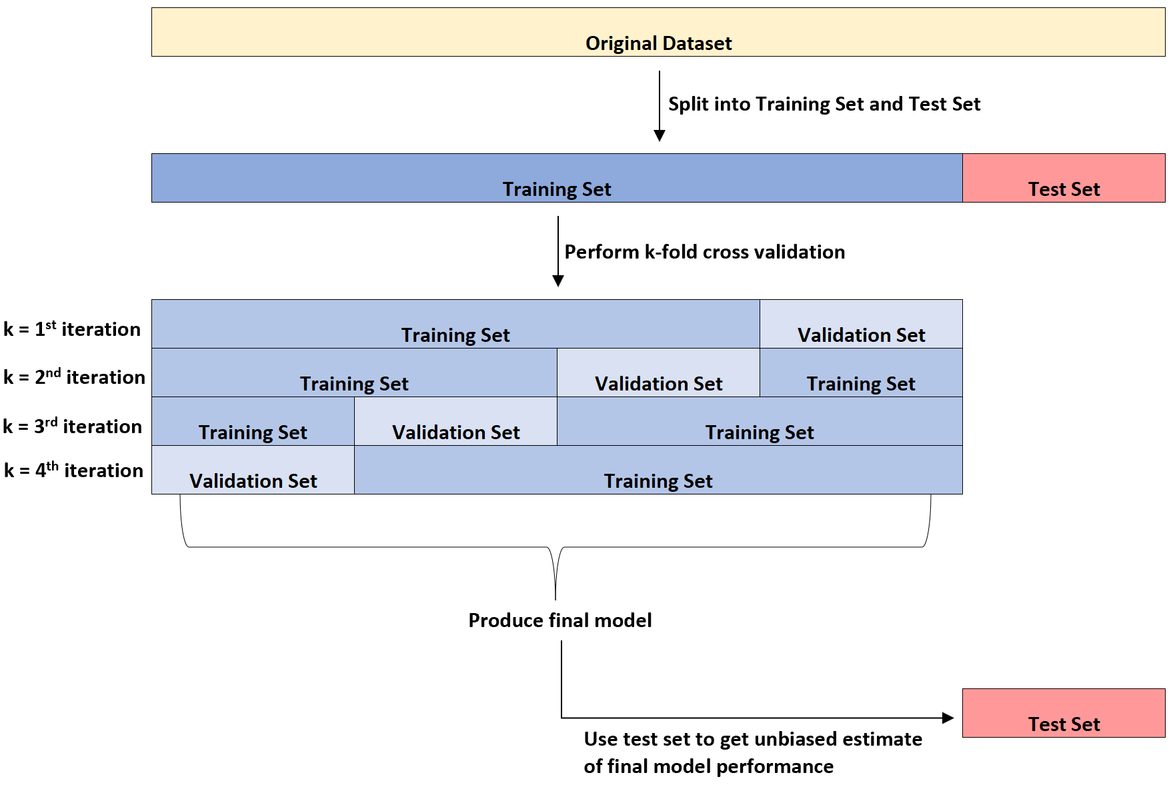
K – fold cross validation

Slide 36
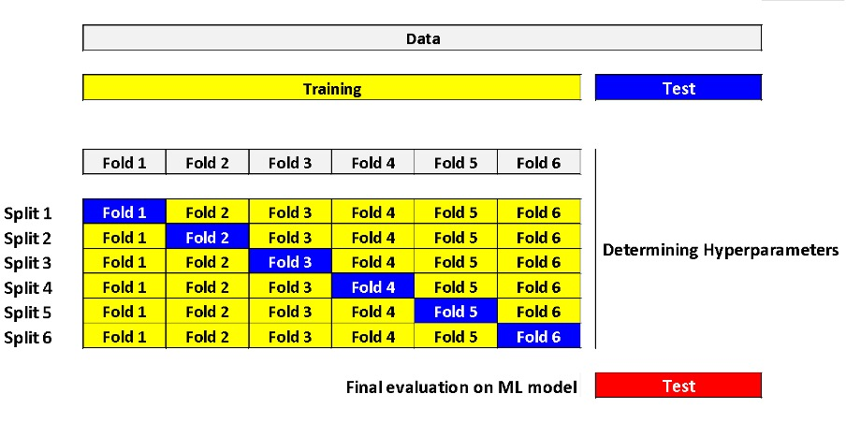
K – fold cross validation

